Slide 1

EGH456 Electrical Vehicle Control Presentation
BY GROUP 16

Slide 2
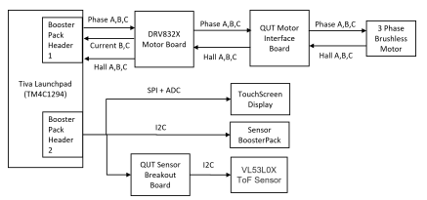
Overview and Objective (Rory)
Context:
Growing demand for Battery-electric and hybrid-electric vehicles
A shift towards electric and autonomous electric vehicle
Objective:
As embedded system engineers, we were required developembedded software for 3 subsystem:
  Motor Control
  Real-Time Sensing
  User Interface
To achieve the objectives, a Simulated Testing Station wasprovided, which included the following (only usedcomponents):
  TM4C1294NCPDT microcontroller
  BOOSTXL-DRV8323RH Motor control Launchpad
  BOOSTXL-Sensor breakout board
  Touch Screen Panel

Slide 3
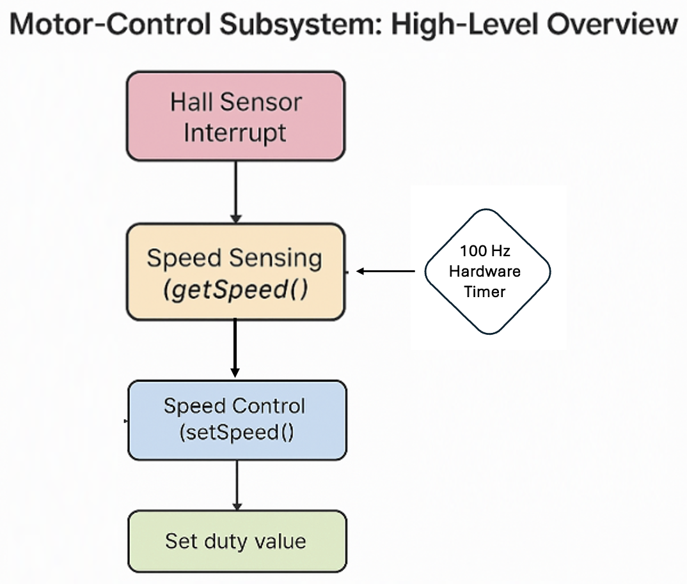
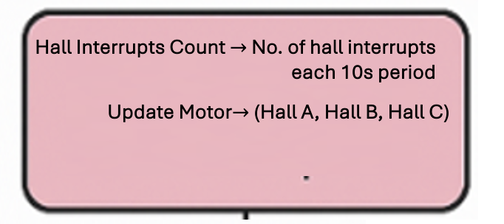
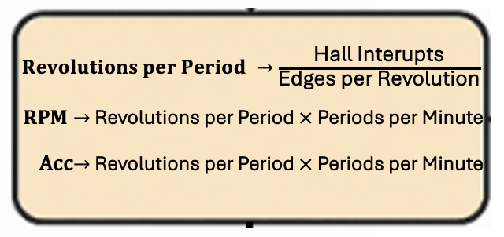
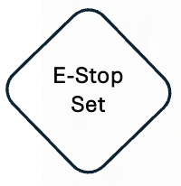
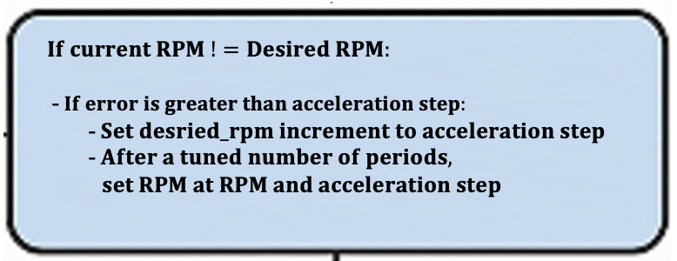
Motor (Joel)
Hall Interrupts Count
AccelStep
= 1000
RPM/s
RPM
Desired
RPM = 0
Duty Value Increment/Decrement

Slide 4
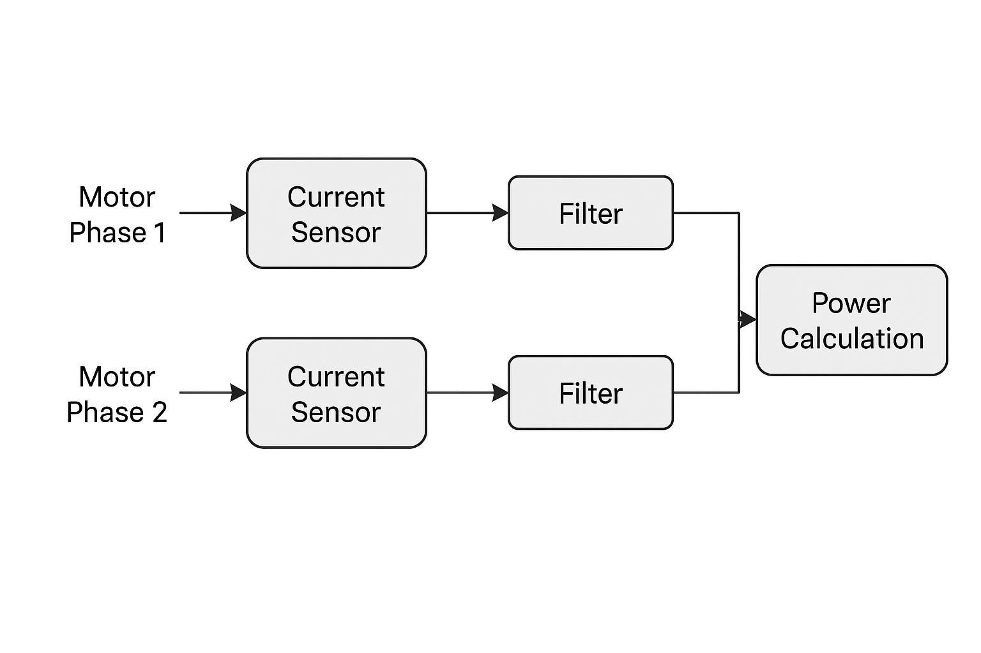
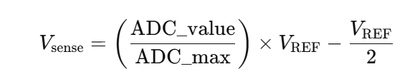
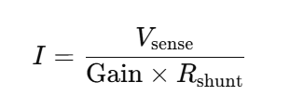
Motor Rpm and Power Sensing (Ben)
Hall Sensors
A, B, C
Edge counter
Sliding Window Filter
Calculate Rpm
Power Sensing
Inputs: Phase B (PD2), Phase C (PE3)
Sampling Rate: Every 6.64 ms (150Hz)
Filtering: Sliding average (10 samples)
Output: Total current and estimated power (based on Vref 24V)
Safety Feature: Overcurrent detection triggers E-stop
Speed(rpm) Sensing
Speed Sensing Highlights
Inputs: Hall A (PM3), Hall B (PH2), Hall C (PN2)
Sampling Rate: Every 10 ms via Timer3A
Filtering: Circular buffer for smoothing RPM
Control: Adjusts duty cycle to match target RPM
E-stop Response: Smooth deceleration when triggered

Slide 5
Light and Acceleration Sensing (Liam)
Light Sensor
OPT3001 sensor to read illuminance in lux
Samples data every 100ms (10Hz)
Moving average filtering to reduce noise (5 window size)
Clamps negative values to zero
Swaps endianness of 16-bit raw data and converts into lux
Low threshold of 50 lux
High threshold of 4000 lux
Acceleration Sensor
BMI160 accelerometer for acceleration
Samples data every 10ms (100Hz)
Reads raw data over I2C with mutex-protected access
Converts raw data into m/s^2

Slide 6

Graphical User Interface (Rory)
Base Requirements
Start/Stop
LED Indicator
Motor RPM Control
Realtime Clock
Set current limit
Set acceleration limit
System Status
E-stop Acknowledgement
Classify Day/Night
Plot Motor RPM
Plot Motor Power Usage
Plot Light Level
Plot Average Absolute Acceleration

Slide 7
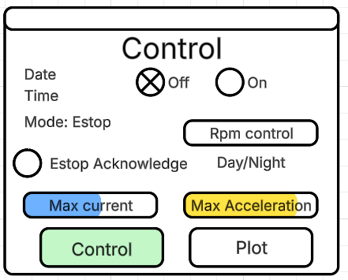
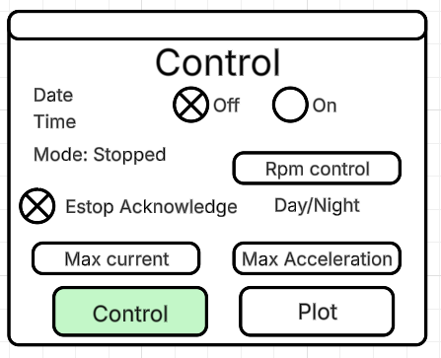
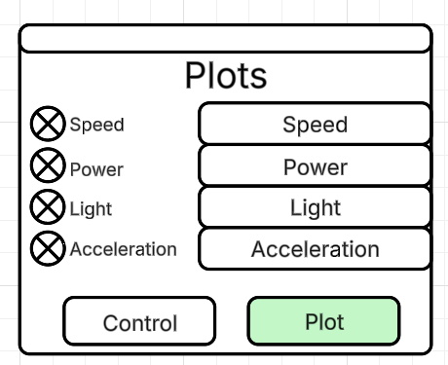
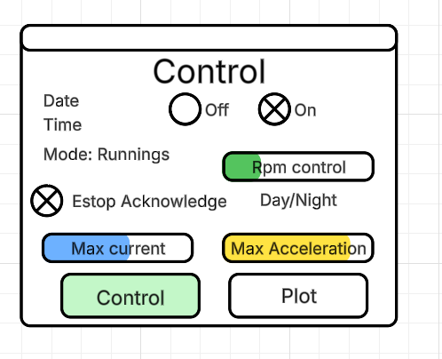
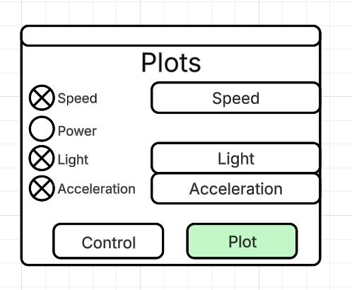
Panels (Rory)
Control Panel
Start/Stop
LED Indicator
Motor RPM Control
Realtime Clock
Set current limit
Set acceleration limit
System Status
E-stop Acknowledgement
Classify Day/Night
Plot Panel
Plot Motor RPM
Plot Motor Power Usage
Plot Light Level
Plot Average Absolute Acceleration

Slide 8

Thank you Listening

